Slide 1


Department of Computer Science and Engineering
DETECTION OF NEUROCOGNITIVE IMPAIRMENT IN THE ELDERLY USING TABNET ALGORITHM
B21A2425C31
Oviya K (210701186)
Navya Balasundaram (210701177)
Dr. Ananthajothi K
Professor

Slide 2
Problem Statement and Motivation
As the elderly population increases, detecting neurocognitive disorders like Alzheimers, Parkinsons and many types of dementia, becomes crucial. These conditions often start with subtle symptoms that are hard to spot using traditional methods, leading to delays in treatment and worsening of the condition. Traditional diagnosis relies on time-consuming manual assessments, which can vary in accuracy.
This technology can provide more accurate and consistent diagnoses, allowing for earlier interventions and better management of these disorders. By integrating deep learning into healthcare practices, we can improve patient outcomes and address the growing challenge of neurocognitive diseases in aging populations.

Slide 3
Objectives
The primary objective of this project is to develop a deep learning model that accurately predicts signs of neurocognitive impairment in the elderly using routine medical check-up data. The system aims to provide healthcare providers with a tool that facilitates diagnosis, allowing for timely interventions and better management of neurocognitive disorders. The alert will be sent to the healthcare providers who can immediately ask their patients to consult their doctors and start treatment as soon as possible. This detection will prevent late diagnosis which will be a ineffective if the disease has already progressed past a threshold. For this project, relevant patient information will be utilized effectively to provide accurate prediction results.

Slide 4
Abstract
The increasing prevalence of neurocognitive disorders among the elderly population rises significant challenges for healthcare systems worldwide. Detection of these impairments can significantly improve patient outcomes by enabling timely intervention and management. This project proposes a deep learning-based solution that uses routine medical check-up data to identify early signs of neurocognitive disorders. By analyzing health metrics, the system aims to provide a reliable, scalable, and more accurate method for detecting cognitive decline. This approach enhances traditional diagnostic methods and offers a more efficient, objective way to support healthcare providers in monitoring and managing neurocognitive health.

Slide 5
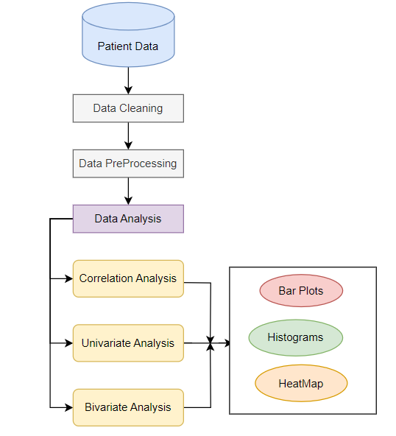
System Architecture
Working of EDA

Slide 6
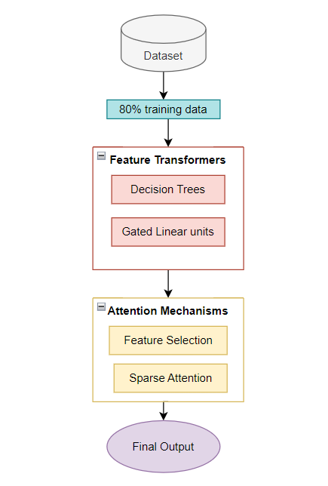
System Architecture
Working of TabNet algorithm

Slide 7
List of Modules
Exploratory Data Analysis on Dataset:
The process in EDA is to visualize how features are distributed to identify relationships with neurocognitive conditions. Sometimes, features like Age and Gender follow typical patterns because cognitive disorders are more common among elderly people. From histograms, we obtain a preliminary sense of how these variables correlate with the outcome under consideration. For eg, Correlation analysis is utilized in mapping relations between factors like Hypertension and CardiovascularDisease. These are very closely associated factors. Last but not least, features like BMI are checked for outliers; clinically relevant values like high blood pressure are retained, but extreme values of BMI might get capped in the process to keep the model sharply focused. Box plots and Histograms are displayed as results of this EDA, to give the final key insights.

Slide 8
List of Modules
Prediction Using TabNet Algorithm:
TabNet has the ability to handle clinical data by transforming the raw data features with the feature transformer layers. These layers are applied to create more sophisticated representations, allowing the model to understand complex interactions among variables. For example, Age, SystolicBP, and CardiovascularDisease are feature interactions that influence the score of cognitive health all at once and are computed to highlight their interaction effect on neurocognitive disorders. The raw inputs being transformed to high-dimensional representations here enable deeper discovery of subtle dependencies relevant to making precise predictions. It utilizes the techniques of batch normalization and sparsity regularization to avoid overfitting and guarantee generalization to vastly diverse patient profiles in their health histories. Following training, the model predicts neurocognitive impairment probability using a holistic view of the patient's health profile.

Slide 9
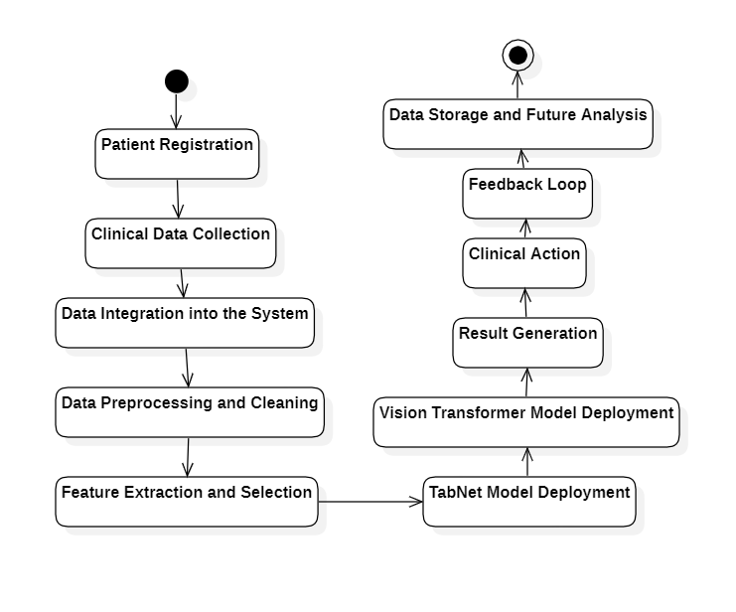
Proposed Activity Diagram

Slide 10
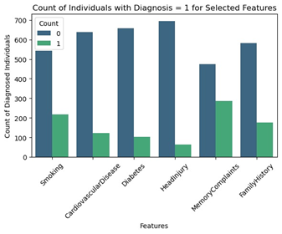
Implementation & Results of First Module
Key Features vs Diagnosed Count

Slide 11
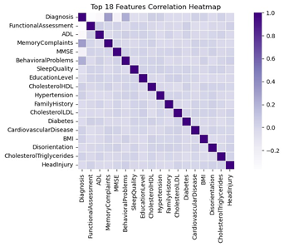
Implementation & Results of First Module
Correlation among 18 features

Slide 12
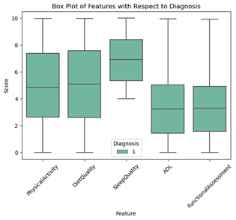
Implementation & Results of First Module
Box-Plot

Slide 13
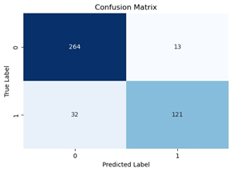
Implementation & Results of First Module
Confusion Matrix

Slide 14
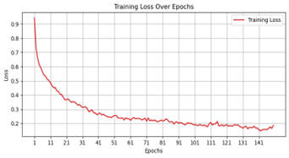
Implementation & Results of First Module
Training loss over epochs

Slide 15
Implementation & Results of First Module
PRECISION | RECALL | F1-SCORE | ACCURACY
0.89 | 0.82 | 0.85 | 0.90
Performance Metrics

Slide 16
Conclusion & Work for Phase II
This study used the TabNet algorithm to analyze tabular data for the early identification of neurocognitive disorders. This model performed the function very well by providing an identification of complex patterns within structured datasets for predictive accuracy and valuable patient health insights. Its strength with handling missing data and interpretation capabilities made it a highly promising tool in the medical field.
The addition of a Vision Transformer will be integrated within the future version of this model in an attempt to study data regarding images as much as data in tabular formats. This multi-modality can be leveraged towards more robust and strong detection methods with better overall accuracies. With our application having images of a demented brain included within its database, neurocognitive disorders are looked forward to being understood extensively at every level, providing proper detection and intervention policies well before the patient crosses some particular threshold.

Slide 17
References
[1] Heising, L. M., & Angelopoulos, S. (2021). Early Diagnosis of Mild Cognitive Impairment with 2-Dimensional Convolutional Neural Network Classification of Magnetic Resonance Images. In Proceedings of the 54th Hawaii International Conference on System Sciences.
[2] Pacheco-Lorenzo, M. R., Valladares-Rodríguez, S. M., Anido-Rifón, L. E., & Fernández-Iglesias, M. J. Smart Conversational Agents for the Detection of Neuropsychiatric Disorders: A Systematic Review. Department of Telematics Engineering at University of Vigo, Escola de Enxeñaría de Telecomunicación, Campus Lagoas-Marcosende, 36310 Vigo, Spain.
[3] Veneziani, I., Marra, A., Formica, C., Grimaldi, A., Marino, S., Quartarone, A., & Maresca, G. Applications of Artificial Intelligence in the Neuropsychological Assessment of Dementia: A Systematic Review.
[4] Shah, S. M. A. H., Khan, M. Q., Rizwan, A., Jan, S. U., Abdel Samee, N., & Jamjoom, M. M. Computer-Aided Diagnosis of Alzheimer’s Disease and Neurocognitive Disorders with Multimodal Bi-Vision Transformer (BiViT). Received: 2 August 2023 / Accepted: 14 June 2024.
[5] Sirilertmekasakul, C., Rattanawong, W., Gongvatana, A., & Srikiatkhachorn, A. The Current State of Artificial Intelligence-Augmented Digitized Neurocognitive Screening Test. Received: 29 December 2022 / Accepted: 20 March 2023 / Published: 30 March 2023.

Slide 18
References
[6] Ghoraani, B., Boettcher, L. N., Tolea, M. I., Galvin, J. E., Hssayeni, M. D., & Rosenfeld, A. “Detection of Mild Cognitive Impairment and Alzheimer’s Disease Using Dual-Task Gait Assessments and Machine Learning”. Department of Computer and Electrical Engineering and Computer Science, Florida Atlantic University, Boca Raton, FL, 33431, USA / Comprehensive Center for Brain Health, Department of Neurology, University of Miami, Miami, FL, 33136, USA.
[7] Rutkowski, T. M., Abe, M. S., Koculak, M., & Otake-Matsuura, M. “Classifying Mild Cognitive Impairment from Behavioral Responses in Emotional Arousal and Valence Evaluation Task–AI Approach for Early Dementia Biomarker in Aging Societies”.
[8] Javeed, A., Dallora, A. L., Rauf, H. T., Berglund, J. S., & Anderberg, P. “Early Prediction of Dementia Using Feature Extraction Battery (FEB) and Optimized Support Vector Machine (SVM) for Classification”. Received: 15 January 2023 / Revised: 30 January 2023 / Accepted: 31 January 2023 / Published: 2 February 2023.
[9] Kamal, M. S., Northcote, A., González Crespo, R., Chowdhury, L., Dey, N., & Herrera-Viedma, E. “Alzheimer’s Patient Analysis Using Image and Gene Expression Data and Explainable-AI to Present Associated Genes”. IEEE Transactions on Instrumentation and Measurement, VOL. 70, 2021, 2513107.
[10] Tsiakiri, A., Bakirtzis, C., Plakias, S., Terzoudi, A., & Christidi, F. “Predictive Models for the Transition from Mild Neurocognitive Disorder to Major Neurocognitive Disorder: Insights from Clinical, Demographic, and Neuropsychological Data”. Received: 27 April 2024 / Revised: 27 May 2024 / Accepted: 29 May 2024 / Published: 1 June 2024.

Slide 19
References
[11] R. K. Mahendran, R. Aishwarya, R. Abinayapriya and P. Kumar, "Deep Transfer Learning Based Diagnosis of Multiple Neurodegenerative Disorders," 2024 International Conference on Emerging Smart Computing and Informatics (ESCI), Pune, India, 2024, pp. 1-4, doi: 10.1109/ESCI59607.2024.10497320.
[12] AlHarkan, K., Sultana, N., Al Mulhim, N., AlAbdulKader, A. M., Alsafwani, N., Barnawi, M., Alasqah, K., Bazuhair, A., Alhalwah, Z., Bokhamseen, D., Aljameel, S. S., Alamri, S., Alqurashi, Y., & Al Ghamdi, K.” Artificial Intelligence Approaches for Early Detection of Neurocognitive Disorders Among Older Adults”. Received: 04 October 2023 / Accepted: 29 January 2024 / Published: 16 February 2024.
[13] Lagergren, M., Fratiglioni, L., Rahm Hallberg, I., Berglund, J., Elmståhl, S., Hagberg, B., Holst, G., Rennemark, M., Sjölund, B.-M., Thorslund, M., Wiberg, I., Winblad, B., & Wimo, A. “A Longitudinal Study Integrating Population, Care and Social Services Data: The Swedish National Study on Aging and Care (SNAC)”.
[14] Luz, S. “Longitudinal Monitoring and Detection of Alzheimer’s Type Dementia from Spontaneous Speech Data”. In 2017 IEEE 30th International Symposium on Computer-Based Medical Systems.
[15] Islam, R., & Layek, M. A. “StackEnsembleMind: Enhancing Well-Being Through Accurate Identification of Human Mental States Using Stack-Based Ensemble Machine Learning”. Department of Computer Science and Engineering, Jagannath University, Dhaka, Bangladesh, 2023.

Slide 20
Paper Publication Status
Accepted at International Conference on Innovative Computing, Intelligent Communication, and Smart Electrical Systems (ICSES-2024).

Slide 21
Thank You

